Slide 1
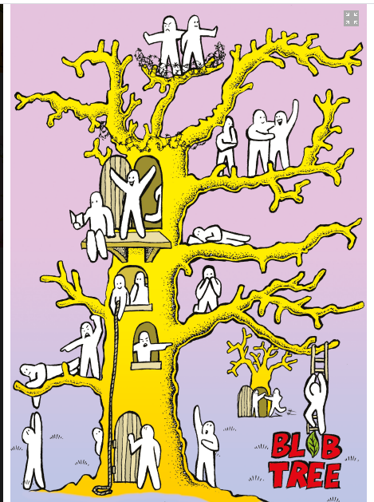
Which blob best represents you and why?

Slide 2
Learning Intentions:
Today we are thinking about why we punish and the purpose of punishment.
Success Criteria:
By the end of the lesson you will be able to:
. List any punishments you have ever received.
. Have considered the motive behind these punishments.
. Be aware of some of the reasons why we punish.

Slide 3
Morality and Justice.
Justice
1. Justice is fairness in the way that people are treated.
2. The justice of a cause, claim, or argument is its quality of being reasonable, fair, or right.
3. Justice is the legal system that a country uses in order to deal with people who break the law.
Morality
Morality concerns the difference between right and wrong, good and bad. This is based on different beliefs and values that people have.

Slide 4
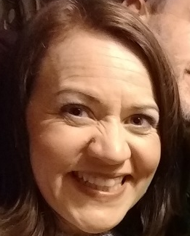
Linking morality and justice
“Issues of morality are entwined with issues of justice.”
So, then how are issues of morality and justice entwined?

Slide 5
Course content
Morality and justice
Purposes of punishment
reformation
retribution
protection
deterrence
Responses to crime
custodial sentences
non-custodial sentences
capital punishment
Todays lesson

Slide 6

24.2.23 Punishment
Within society it is generally agreed that committing acts that are ‘wrong’ should result in punishment for the wrongdoer. Punishments are connected to a society's rules and laws.
There’s also a general agreement that the punishment should fit the crime.
Therefore when thinking about the issue of punishment the most important question to ask is ‘what is the purpose of the punishment?’

Slide 7

Punishments we have received
As a class we are going to make a list of any punishments we can think of.
These may be given from teachers, people you live with, the police or even friends.
Lets think.
What was the point of the punishments you received? Did it work?

Slide 8
In modern society we commonly recognize 4 purposes behind punishment.
All 4 purposes are regularly reflected in the Scottish legal system and often a combination of some or all of these purposes lie behind particular punishments.
Reform.
Retribution.
Protection.
Deterrence.

Slide 9

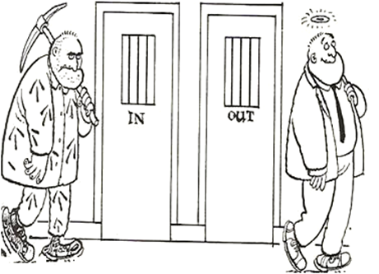
Reform: The idea that a punishment should try to change criminals so that they will not commit crimes again.
Some see punishment as a way to reform offenders so they do not want to break the law again.
Reform can include training and education.

Slide 10


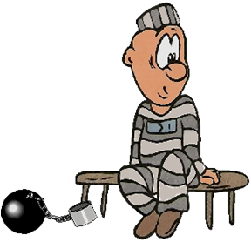
Retribution: The idea that a punishment should make the criminals suffer.
Some believe that a person should suffer for what they have done. This gives society and the victims of crime a feeling of justice.
Punishments should also match the severity of the crime.

Slide 11
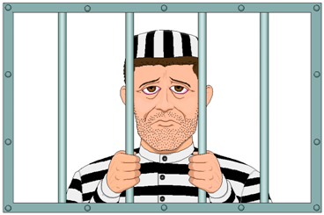
Protection: The idea that the punishment should be primarily about protecting society from the criminal.
One of the ideas of punishment is to protect society from the acts of criminals, particularly violent ones, by imprisoning them so they cannot harm society.
If a prisoner is in prison then they can no longer harm anyone.
As a result society should be safer.

Slide 12
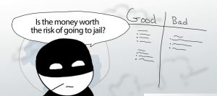
Deterrence: The idea that a punishment will be of such a nature that they will put people off (deter) them from committing a crime.
The idea of deterrence is preventative.
The punishment given is severe enough to deter others from committing the same offence or possibly re-offending.
For example if someone knows they will have their hand cut off if they are caught stealing; then they will not steal; if people know they will be executed if they are caught murdering, they will not murder.

Slide 13
So lets talk about your reaction to these four purposes, what do you think of them? Do you think any of them are better or more morally correct than others?
Reform.
Retribution.
Protection.
Deterrence.
Can you see the link between any of the punishments you received and theses purposes?

Slide 14

A few things…..
E of G essays
Senior profiles
2nd prelim: 27th Feb 90mins
6th March 45 mins
Small group tutoring.

Slide 15


Homework
Watch: Black Mirror: Series 2 episode two “White Bear.”
No spoilers if you’ve already seen it! You can find it on youtube.
Be ready to talk about it next Tuesday.
It might be worth taking notes or watching it a couple of times. Focus on this question “ What is the form of punishment being used and do you think it is morally acceptable?”

Slide 16
Course content
Morality and justice
Purposes of punishment
Responses to crime
custodial sentences
non-custodial sentences
capital punishment
Todays lesson
The 4 purposes of punishment are?

Slide 17
The 4 purposes of punishment are?
Deterrence - punishment should put people off committing crime.
Protection - punishment should protect society from the criminal and the criminal from themselves.
Reformation - punishment should change the criminal.
Retribution - punishment should make the criminal pay for what they have done wrong.

Slide 18
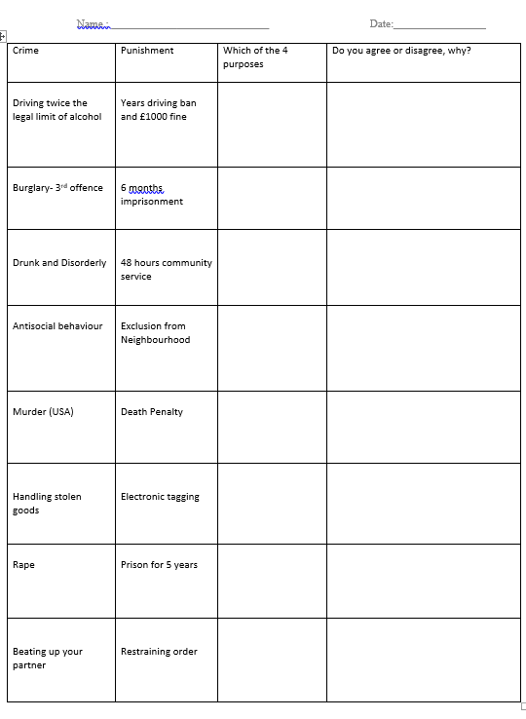

Task: Complete this worksheet.
Think carefully about your opinion about these forms of punishment.

Slide 19
Task:
1. Which do you think is the most important aim of punishing someone?
Why?
Give two reasons for your answer.
2. Are there any crimes that should be forgiven and remain unpunished?
Why?
Give two reasons for your answer.

Slide 20
Homework
Watch: Black Mirror: Series 2 episode two “White Bear.”
No spoilers if you’ve already seen it! You can find it on youtube.
Be ready to talk about it next Tuesday.
It might be worth taking notes or watching it a couple of times. Focus on this question “ What is the form of punishment being used and do you think it is morally acceptable?”

Slide 21
Tasks: To be completed by Tuesday 19th10am
1. “In Black mirror and the episode White Bear we see a new form of punishment being used by the UK legal system. This involves a form of retribution for a convicted child murderer.
The interesting thing was ….
2. Which do you think is the most important aim of punishing someone? Why? Give two reasons for your answer.
3. Are there any crimes that should be forgiven and remain unpunished? Why? Give two reasons for your answer.

